Slide 1
ML-flow
Track, Reproduce, and Deploy Machine Learning Models with Ease

Slide 2
Agenda
What is ML-flow ?
6WH Model
Live Demo
Q&A

Slide 3

What is ML-flow?
Open-source platform to manage end-to-end ML lifecycle.
Tracking – log/compare experiments.
Projects – package ML code in a reproducible format.
Models – manage and deploy models across environments.
Registry – centralized model store with versioning

Slide 4

Challenges in ML-flow
ML projects involve many experiments, models, environments → hard to track
Experiment tracking
Reproducibility
Model deployment & versioning

Slide 5

Why ML-flow?
Unified tracking
Standard packaging
Flexible deployment (local, cloud, containers)
Align with ML-Ops

Slide 6

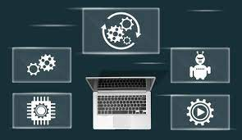
What if ML-flow is NOT Available?
Manual experiment logging → spreadsheets, notes, screenshots
Difficult to reproduce results
Model deployment → inconsistent & error-prone
No central model registry → collaboration issues
Slows down ML → production pipeline

Slide 7




What are the Alternatives?
Kubeflow – Full-fledged ML pipeline orchestration
Weights & Biases (W&B) – Popular for experiment tracking
Neptune ai – SaaS for tracking & management
DVC (Data Version Control) – Data & model versioning

Slide 8
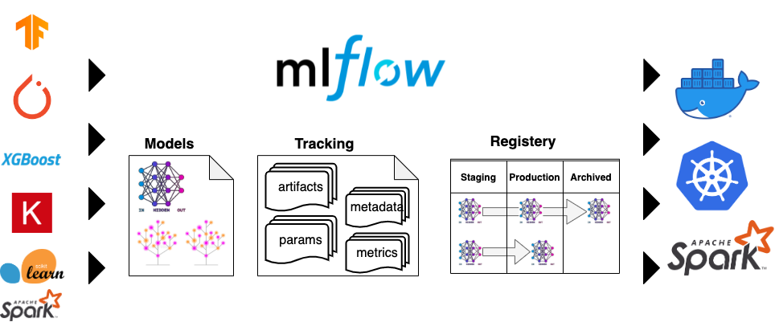
When to Use ML-flow?
Teams doing frequent ML experiments
Need to compare and reproduce results
MLOps adoption for model lifecycle
When multiple teams work on shared ML projects
For hybrid deployment (local dev → cloud/production)

Slide 9
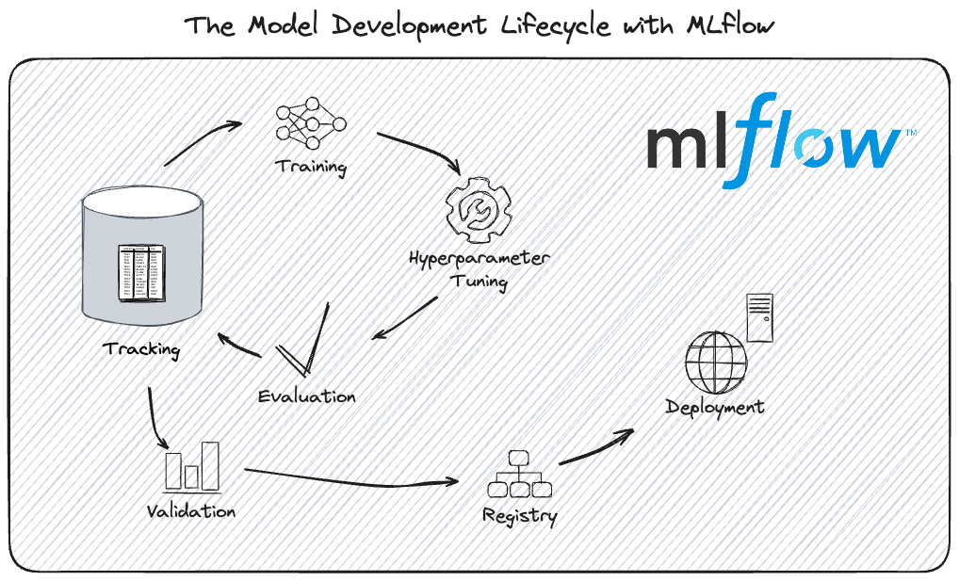
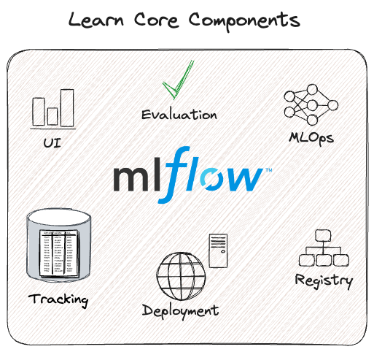
Best Scenarios for ML-flow
Data scientists running experiments with different parameters
Organizations needing model registry with approvals
Deploying models to REST APIs, Docker, or cloud platforms
ML projects requiring auditability and reproducibility
Integrating with existing ML-Ops stack

Slide 10

How to implement ML-flow?
Experiment tracking
Run comparison
Model registry with versions
Log a model & deploy it as a REST API
Call API with sample input & verify prediction

Slide 11

Summary
ML-flow simplifies ML lifecycle management
Provides tracking, projects, models, registry
Helps teams collaborate & reproduce experiments
Flexible for local → production deployment
Live POC: log an experiment, register model, serve API

Slide 12

Q & A

Slide 13
Abishek K
Junior - Software Engineer

